Slide 1
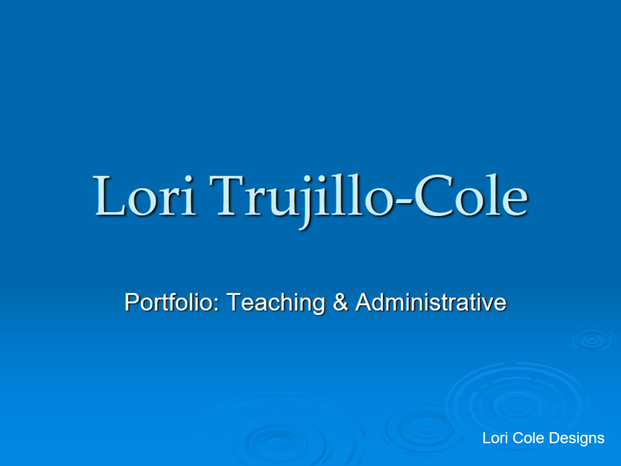
Lori Trujillo-Cole

Slide 2
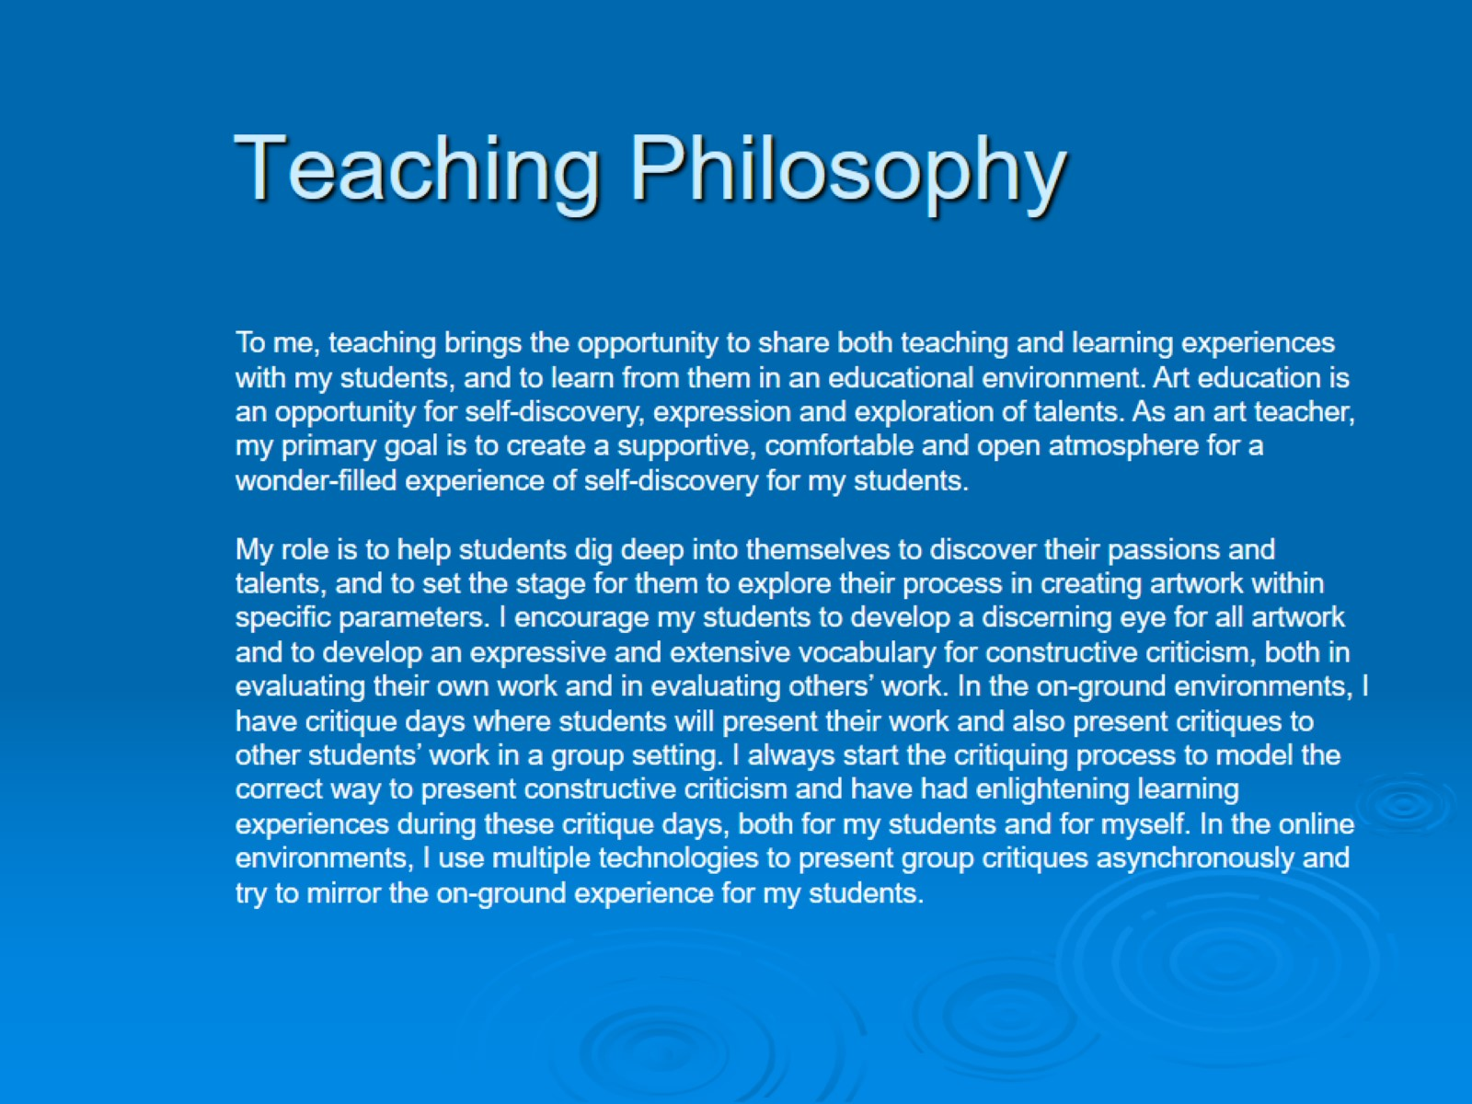
Teaching Philosophy

Slide 3
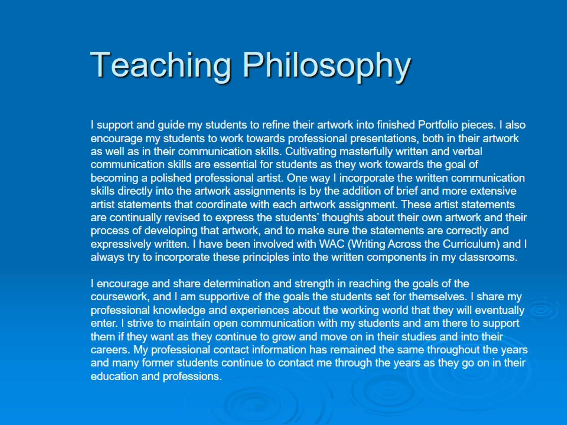
Teaching Philosophy

Slide 4
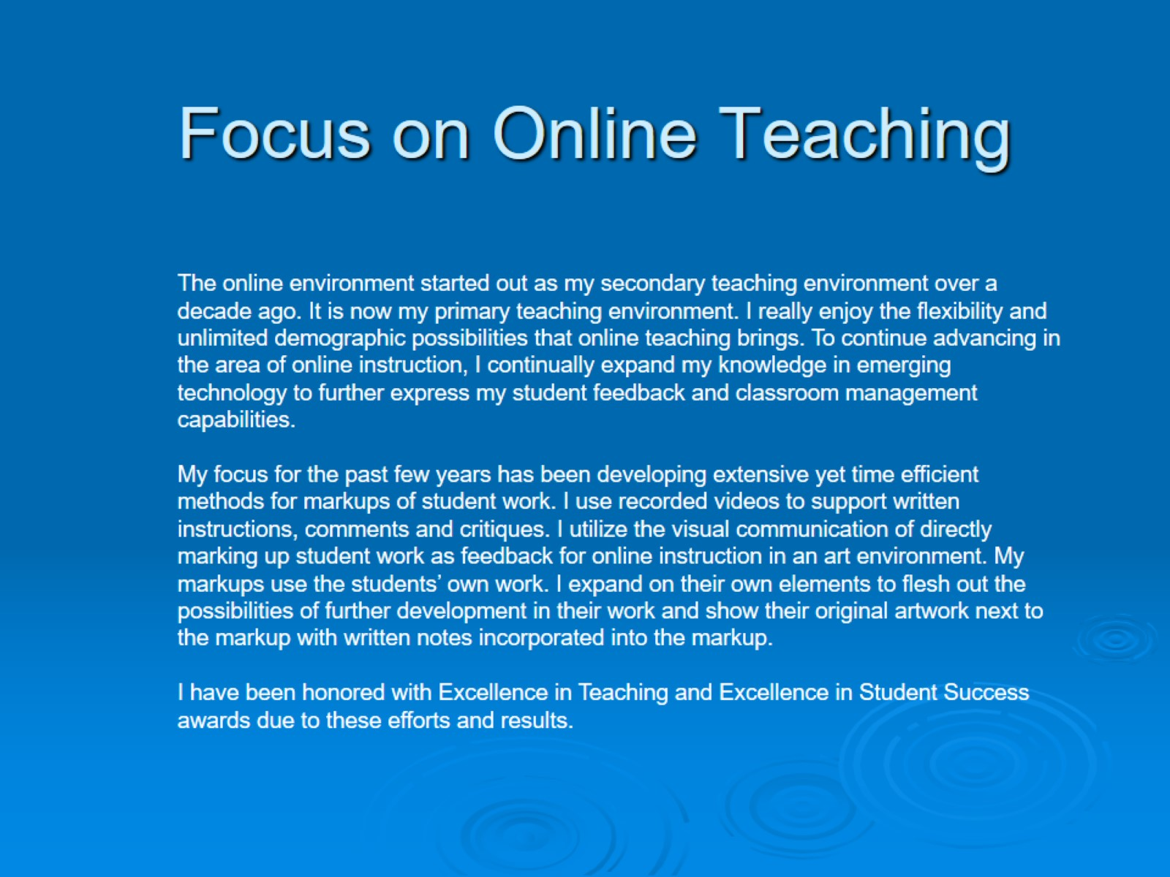
Focus on Online Teaching

Slide 5
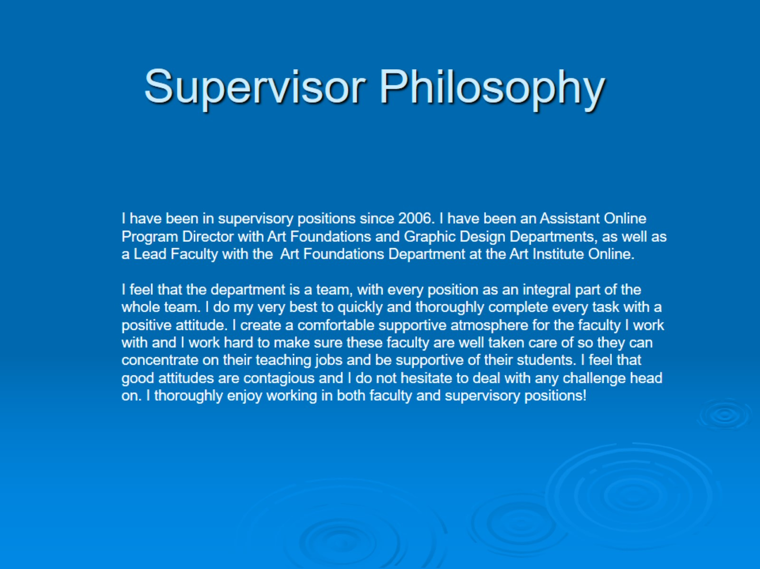
Supervisor Philosophy

Slide 6
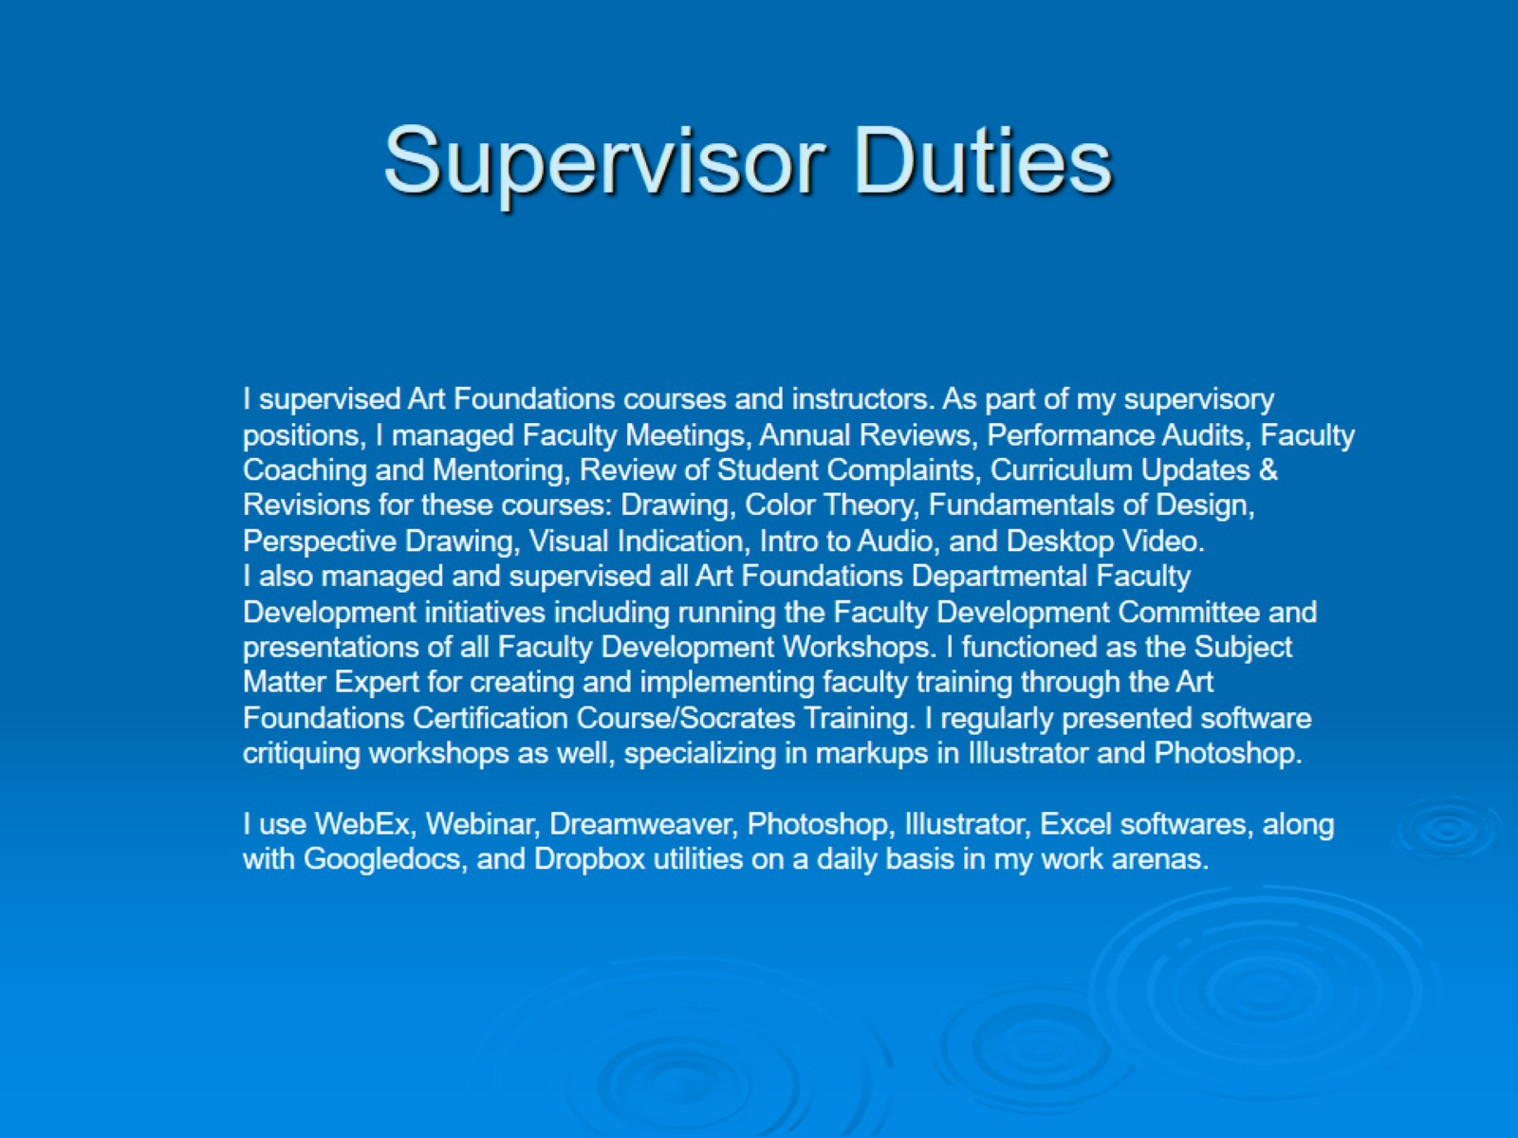
Supervisor Duties

Slide 7
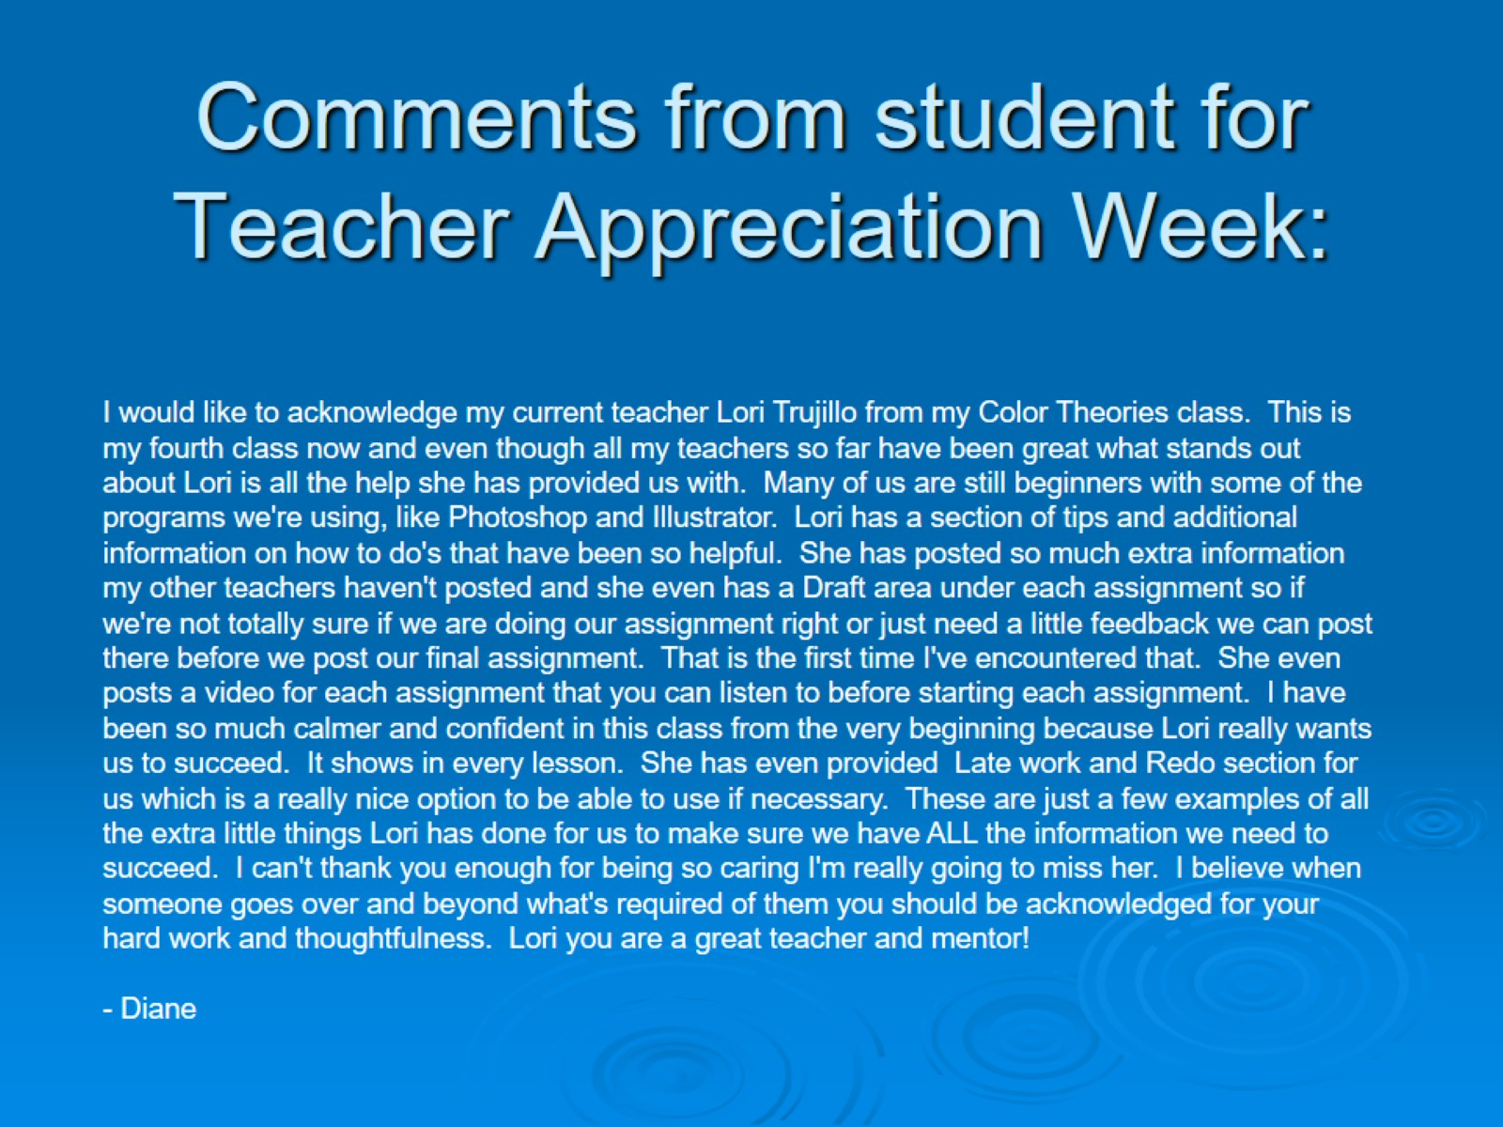
Comments from student for Teacher Appreciation Week:

Slide 8

Student Work

Slide 9
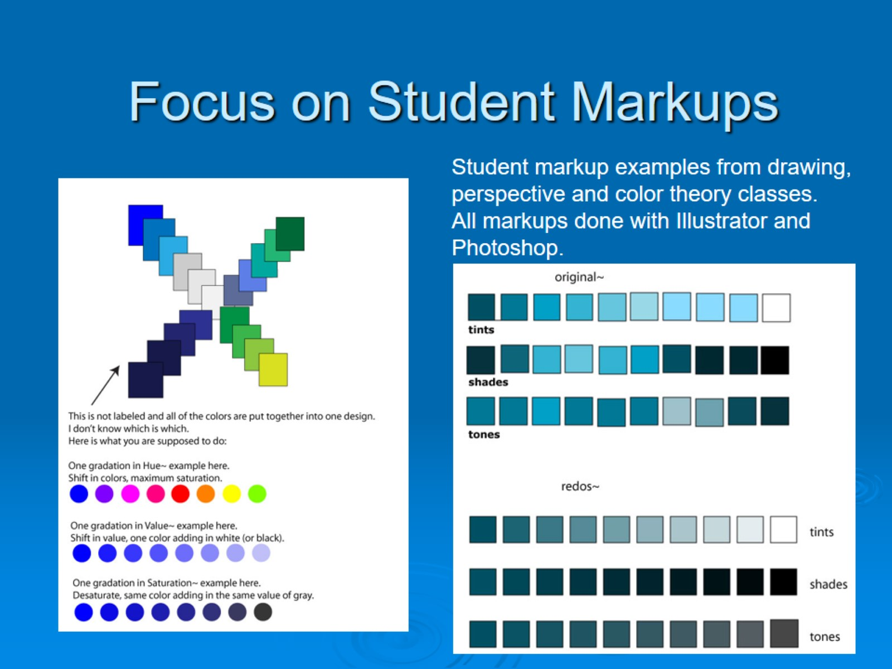
Focus on Student Markups

Slide 10
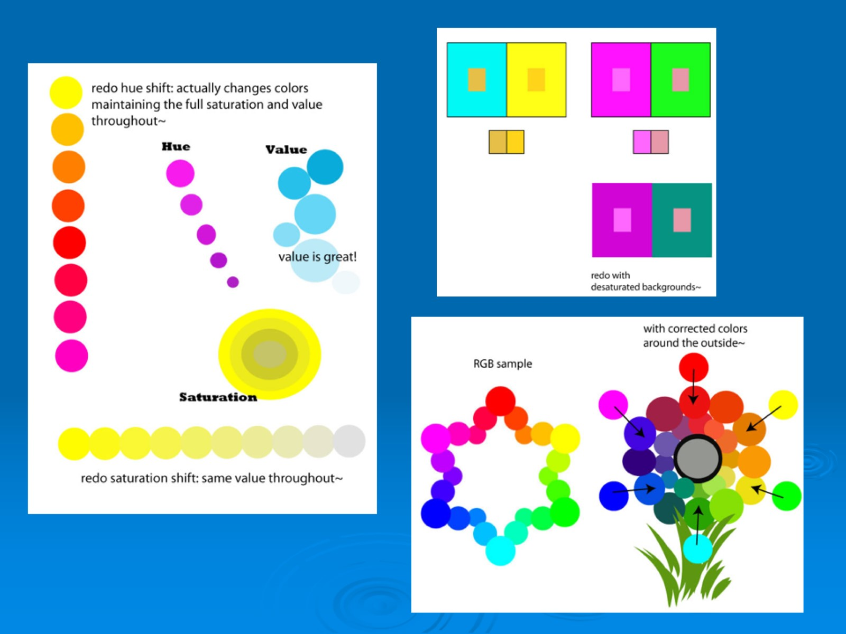

Slide 11
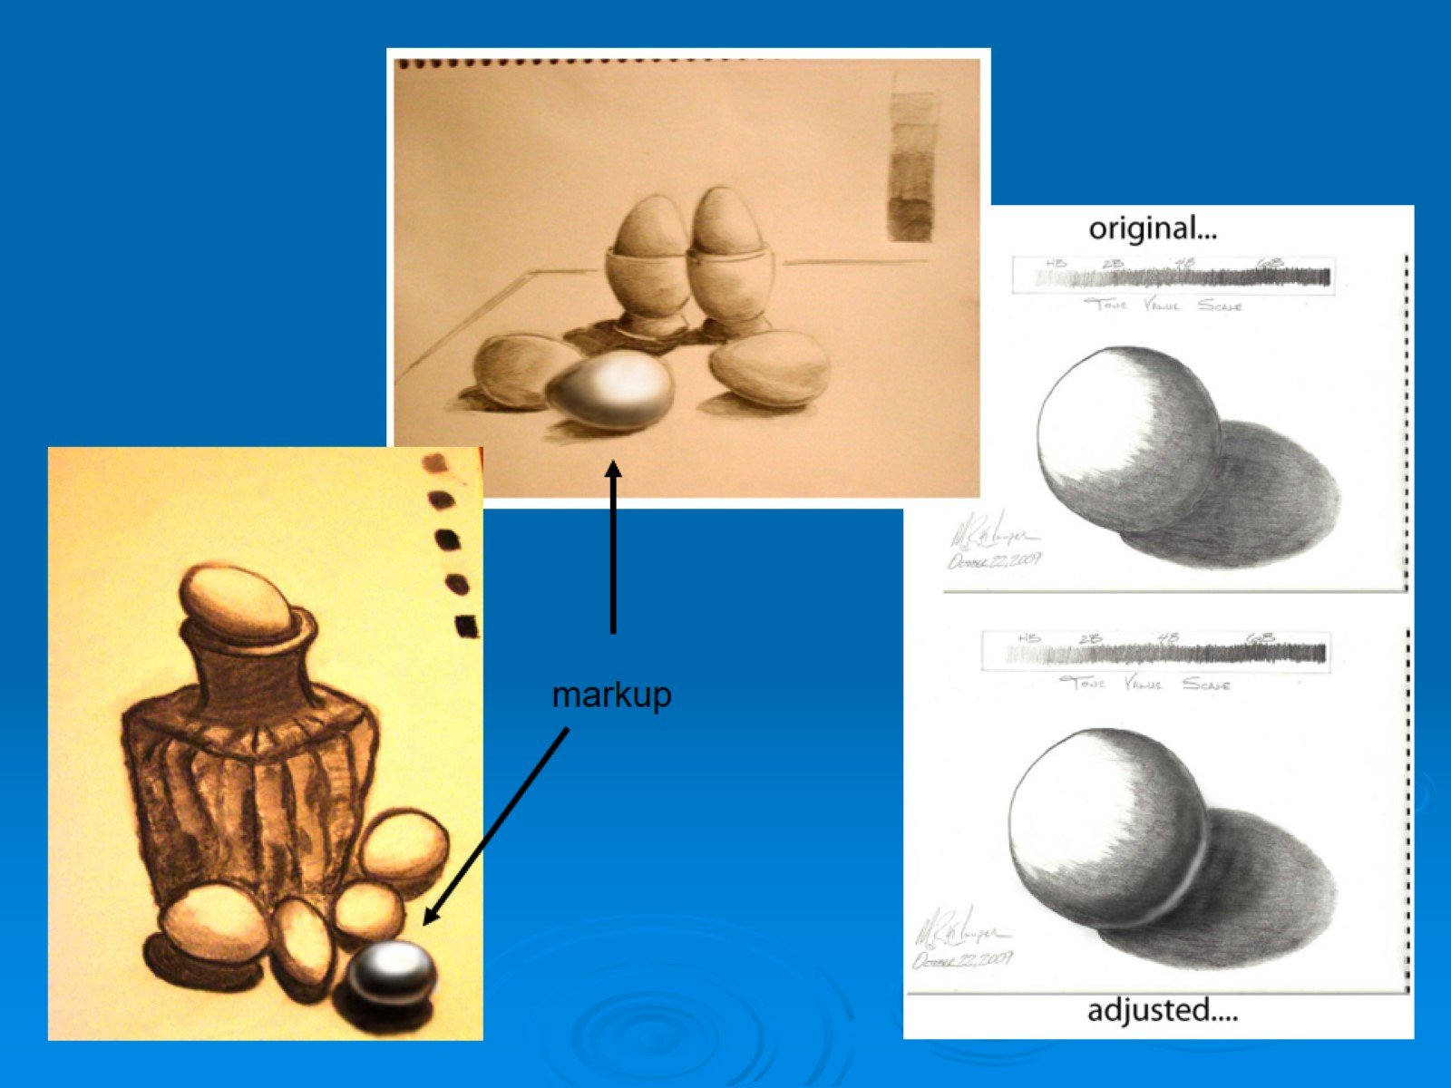

Slide 12
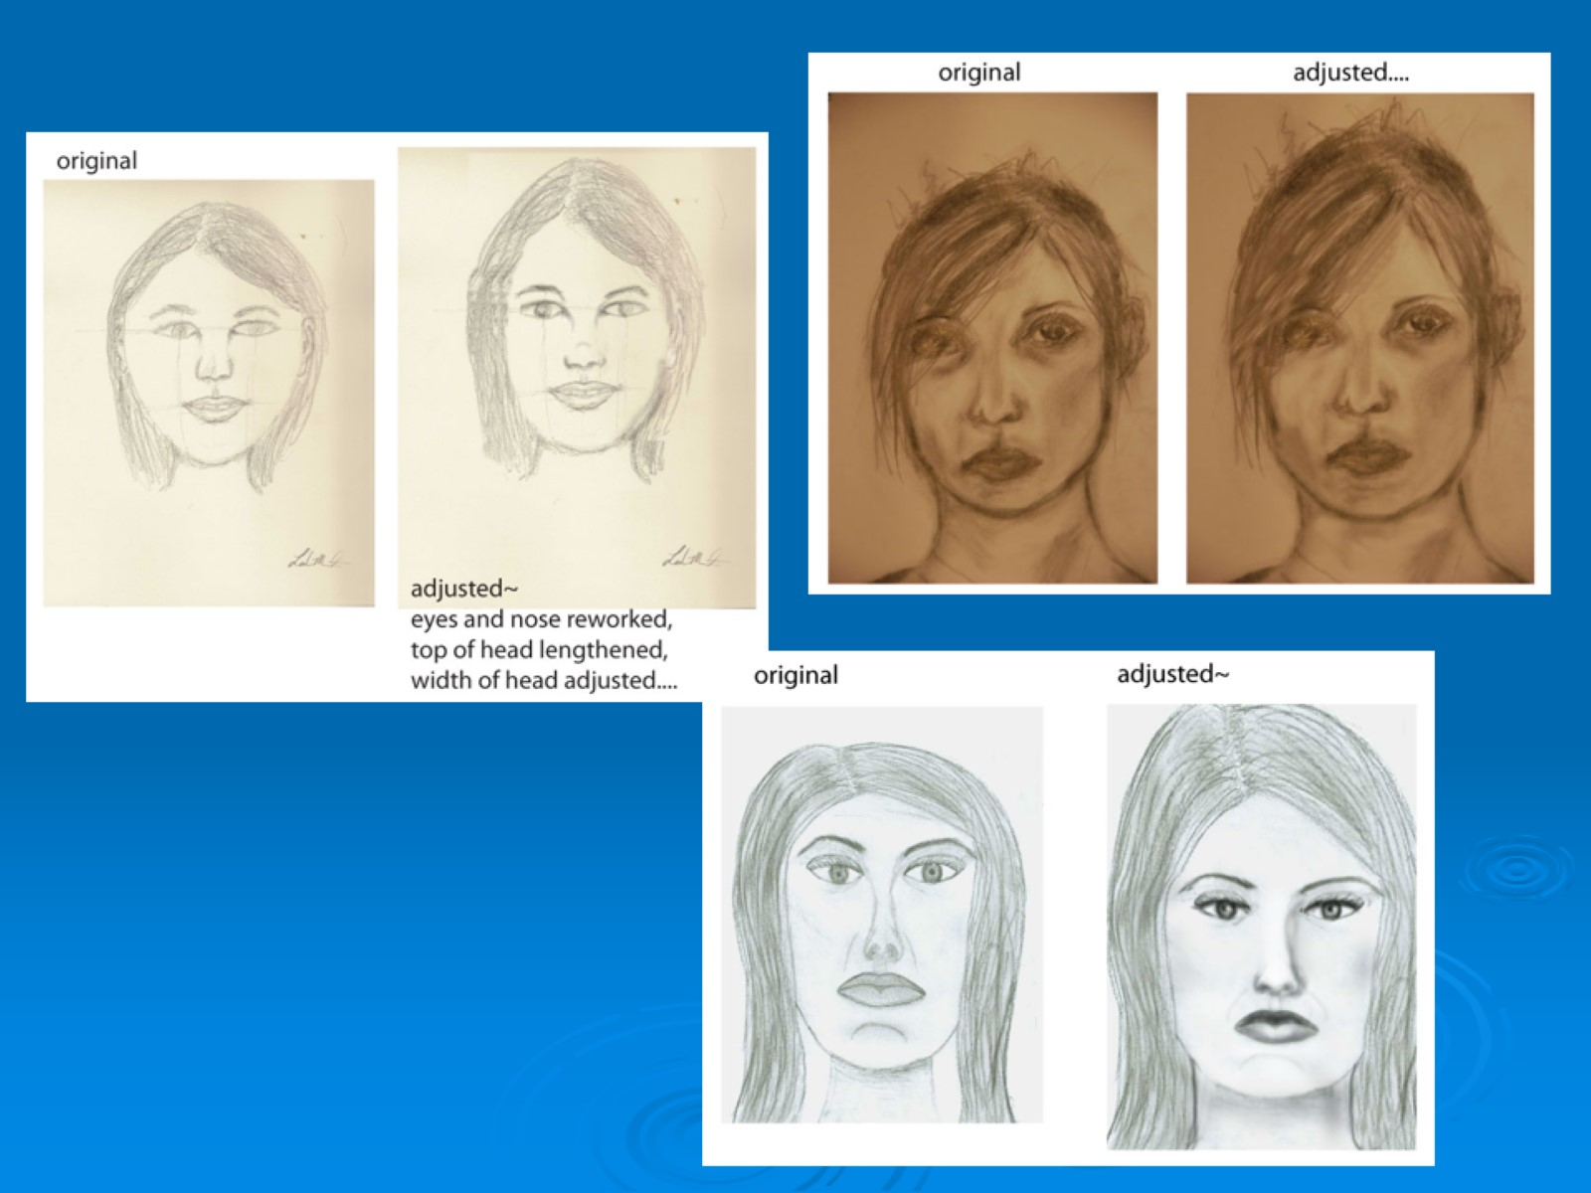

Slide 13
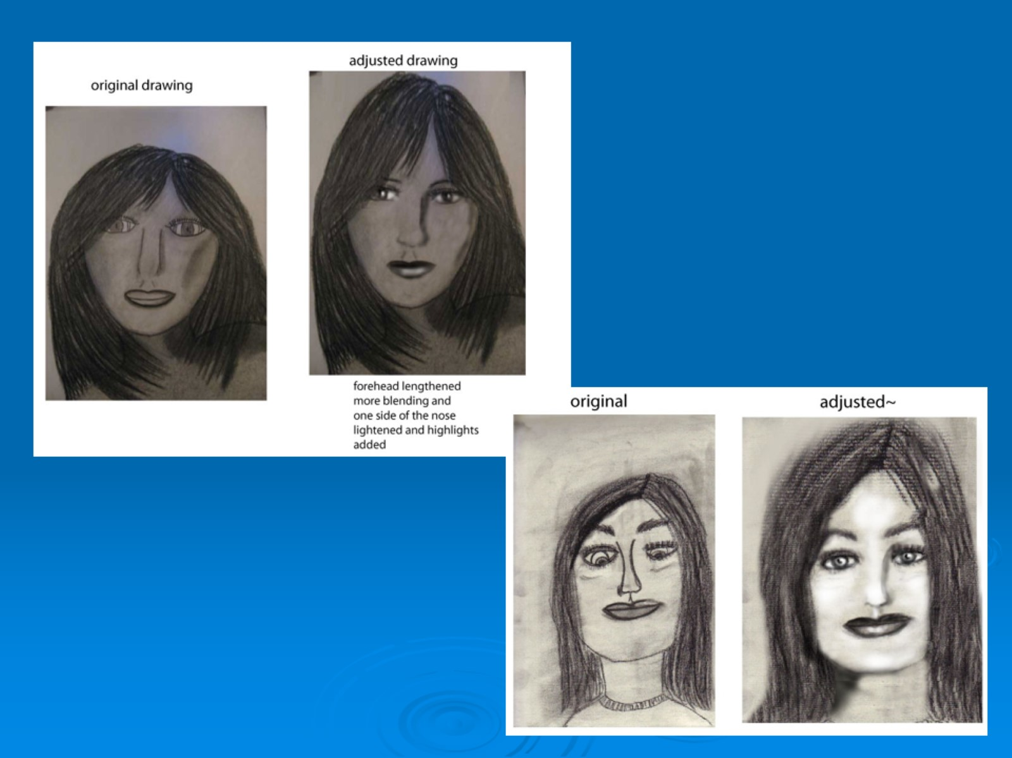

Slide 14
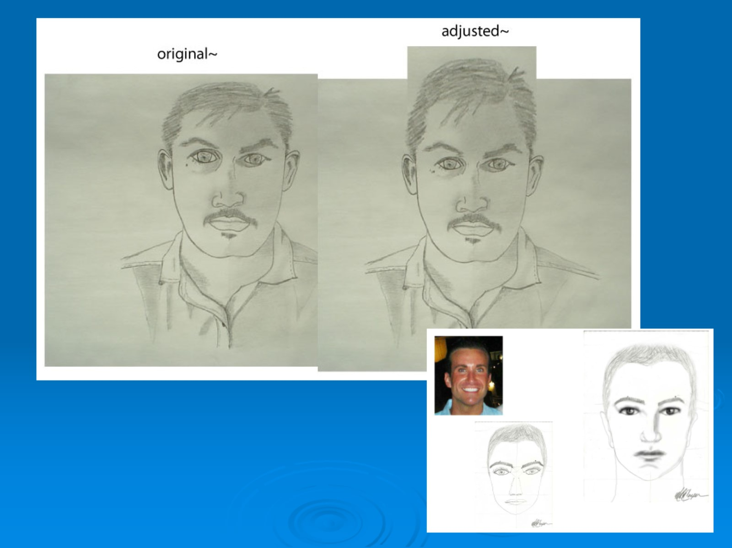

Slide 15
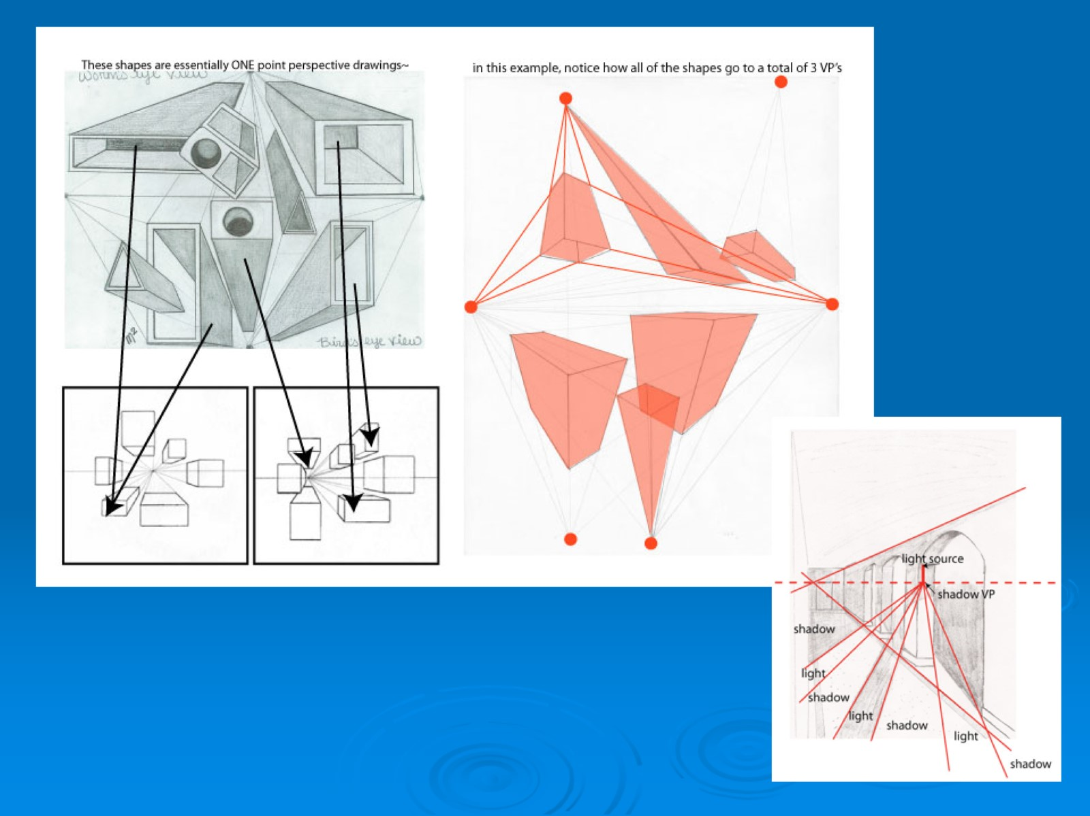

Slide 16
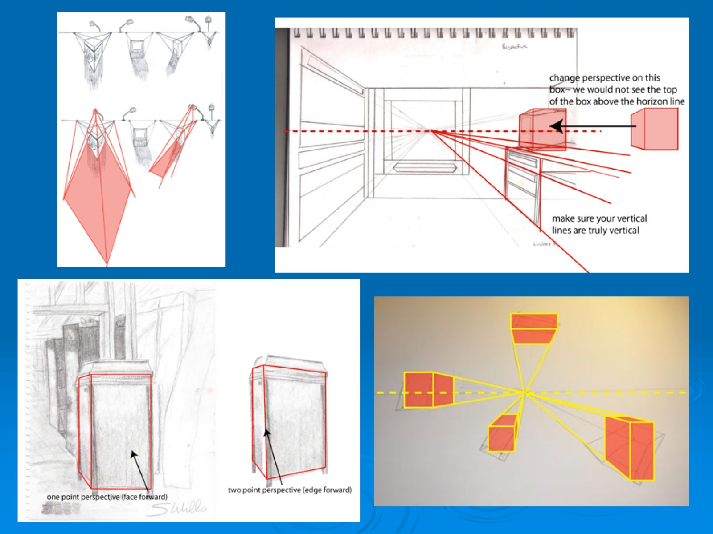

Slide 17
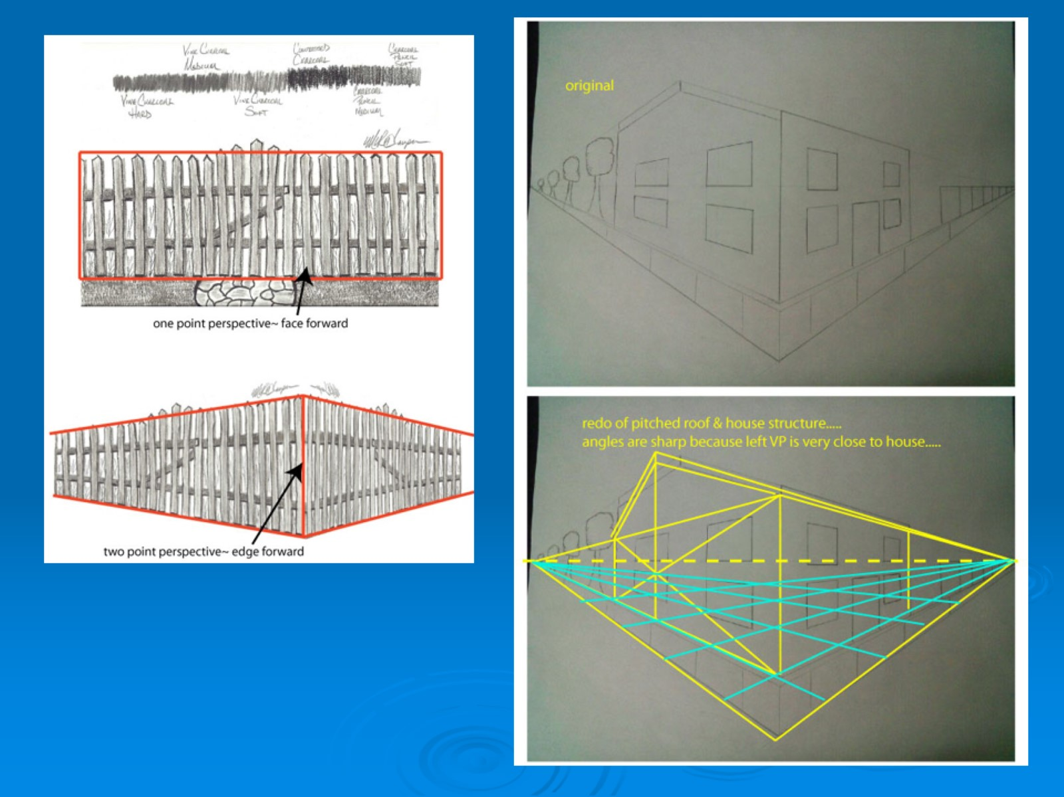

Slide 18

Feedback….

Slide 19
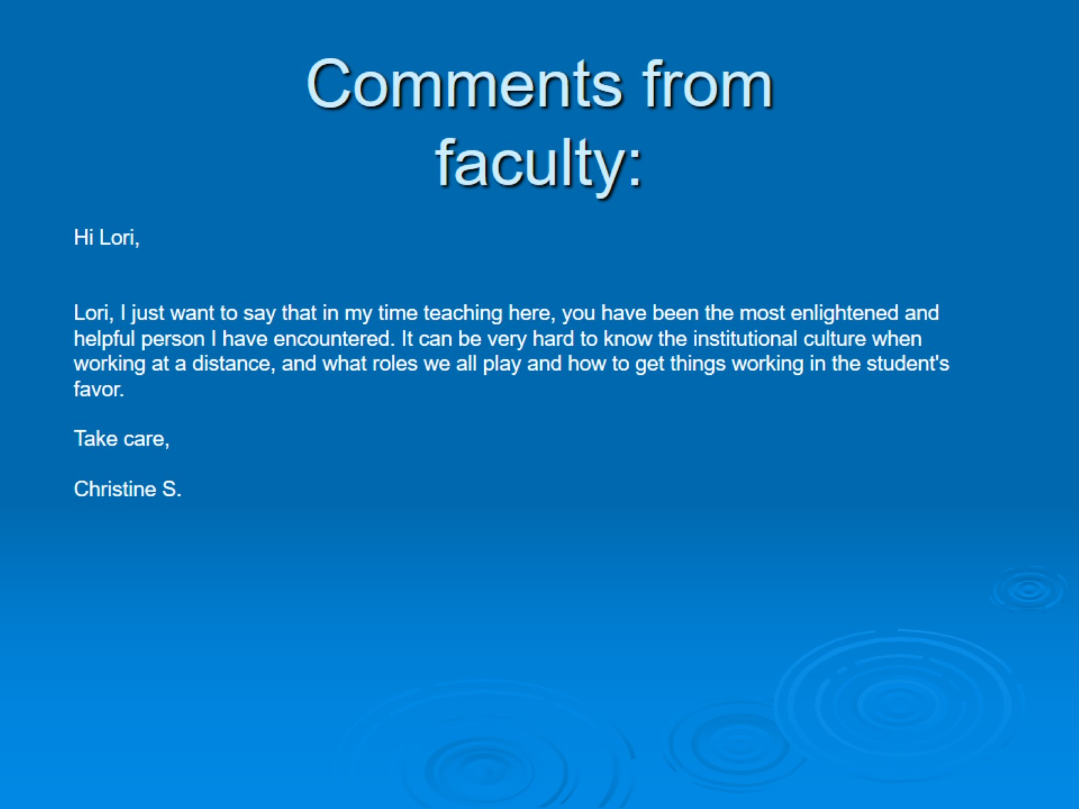
Comments from faculty:

Slide 20
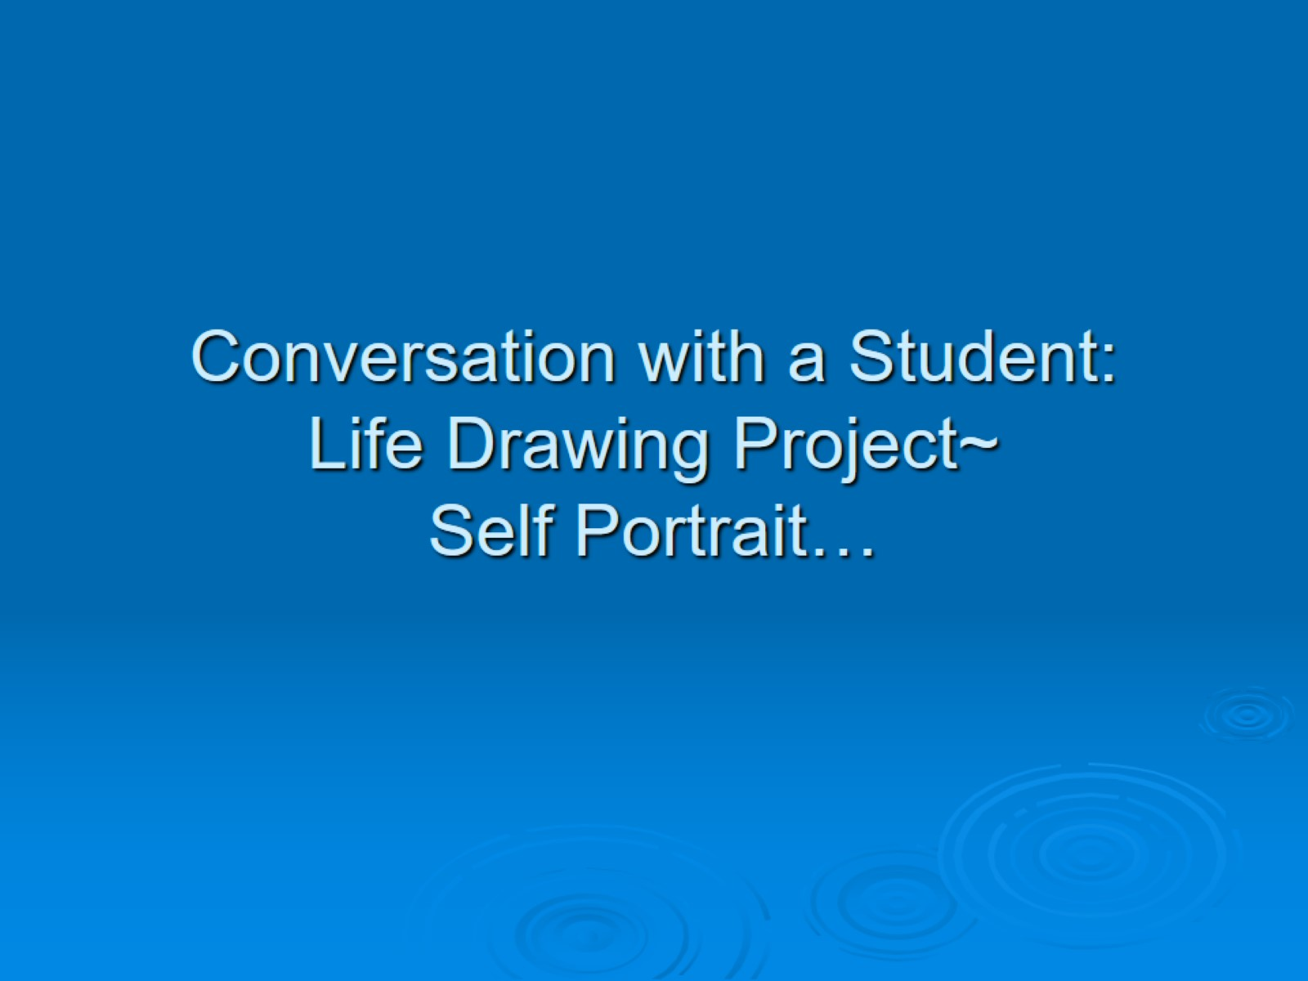
Conversation with a Student: Life Drawing Project~ Self Portrait…

Slide 21
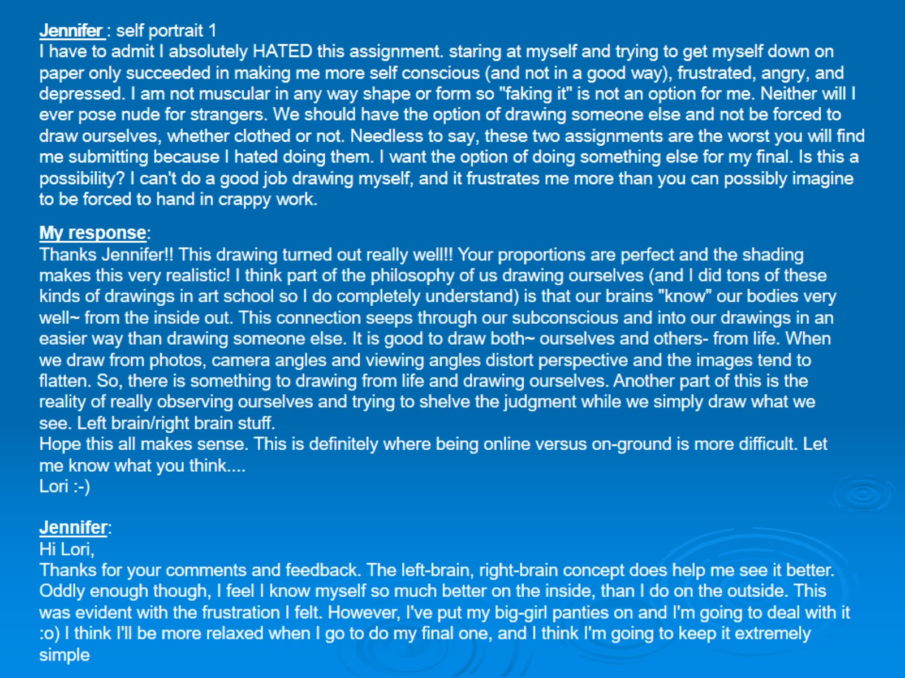

Slide 22
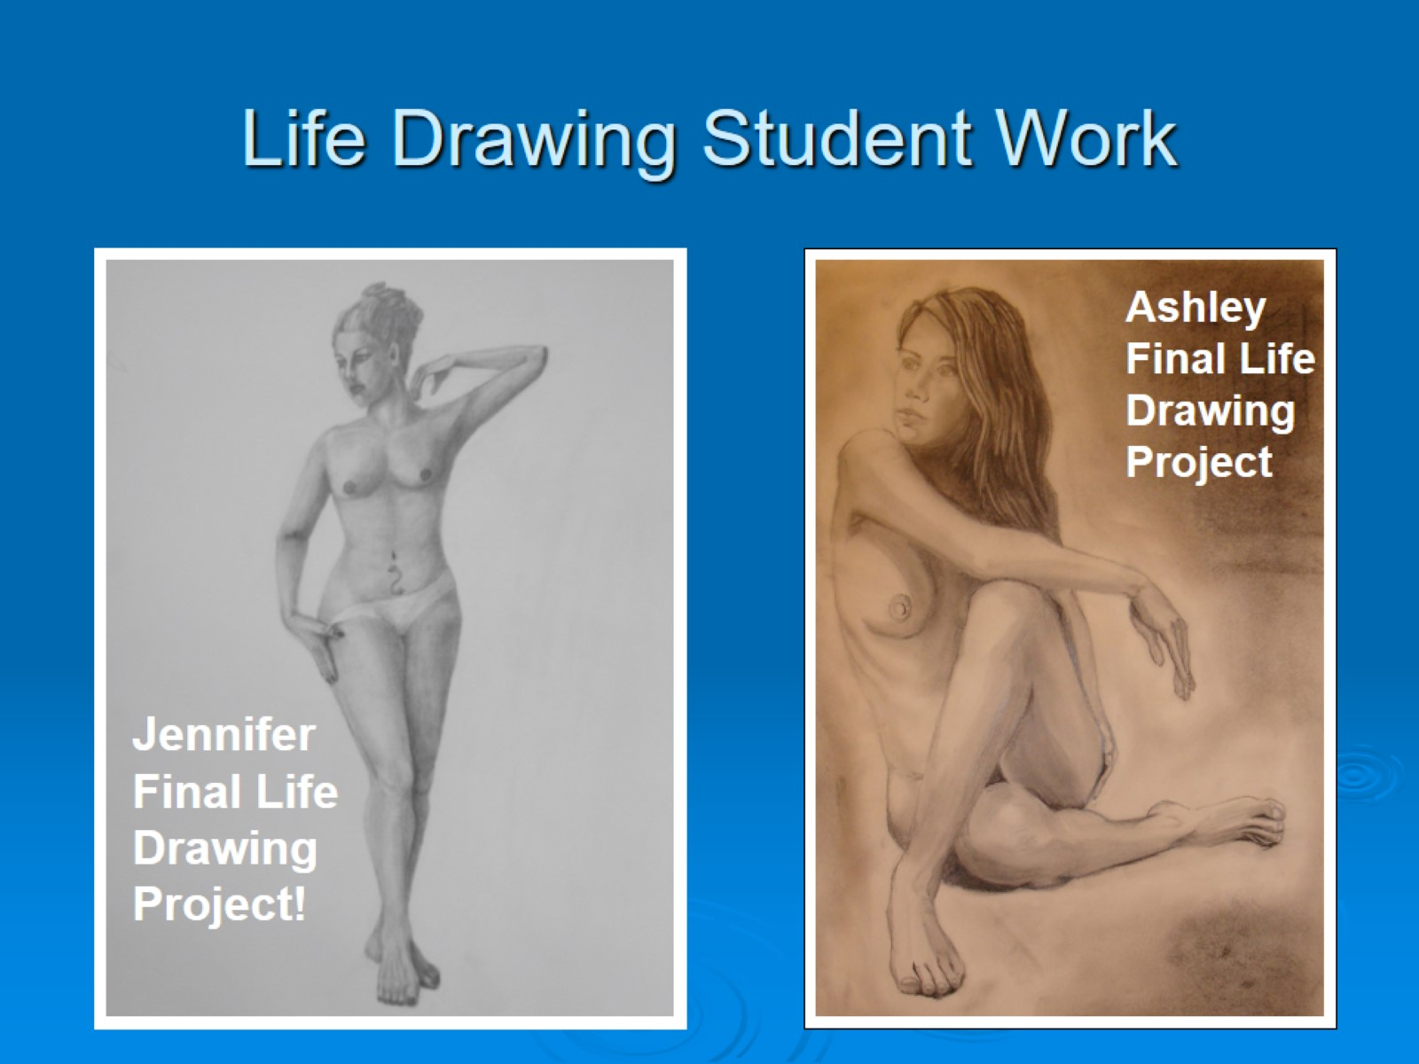
Life Drawing Student Work

Slide 23
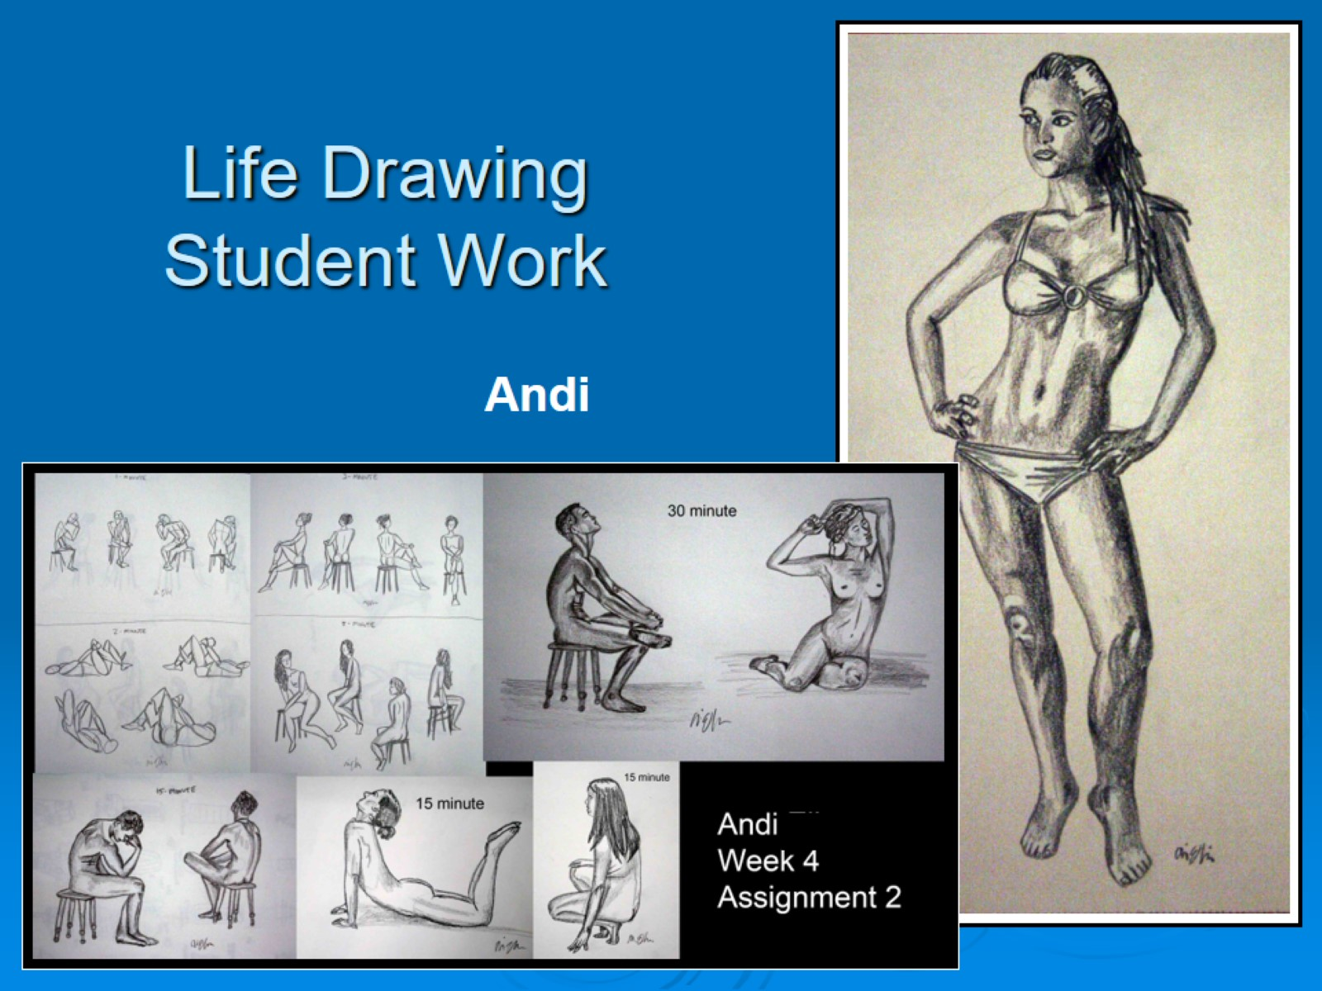
Life Drawing Student Work

Slide 24
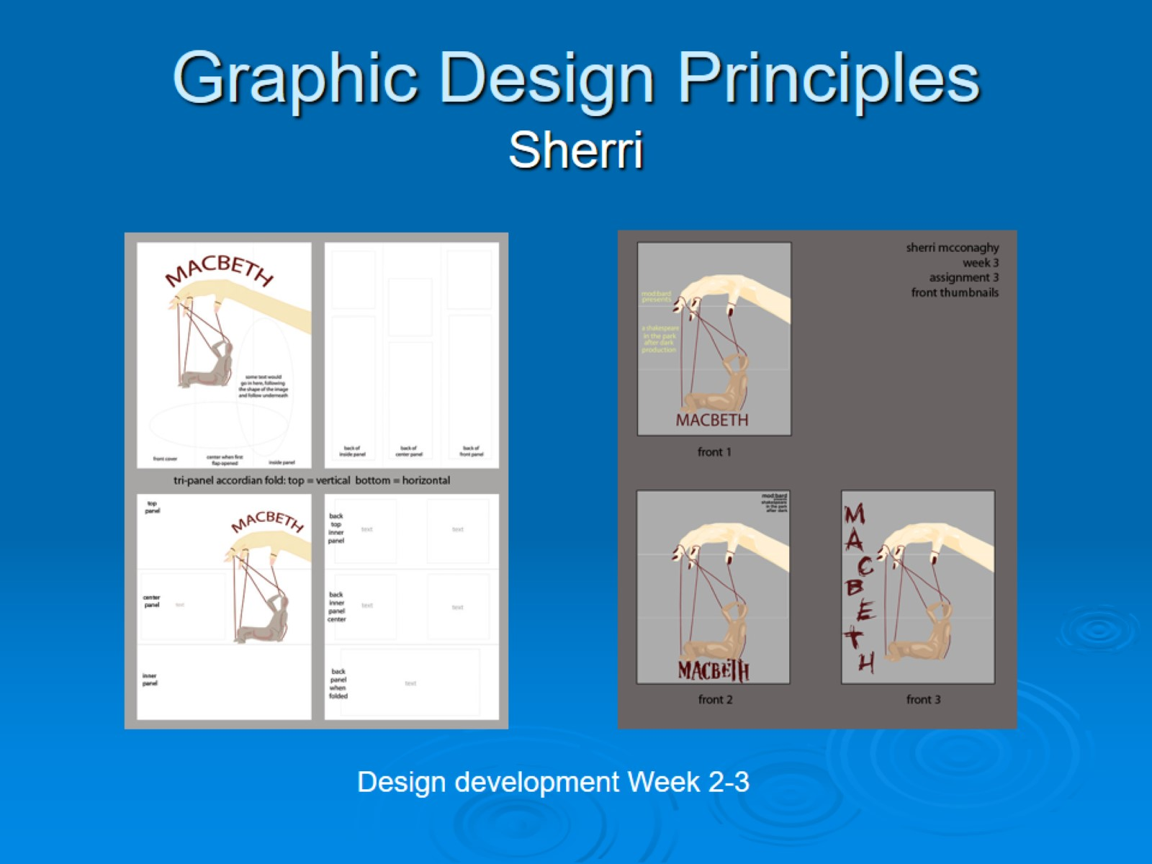
Graphic Design Principles Sherri

Slide 25
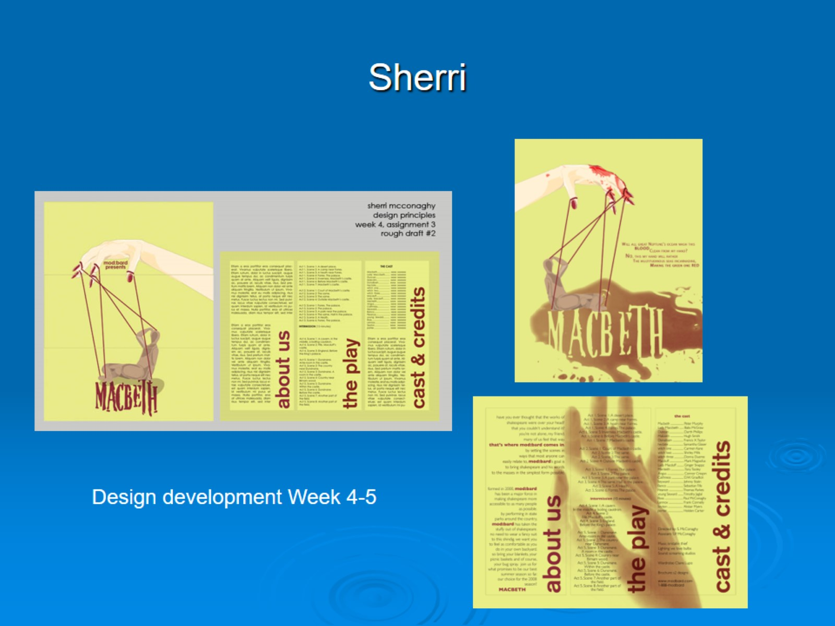
Sherri

Slide 26
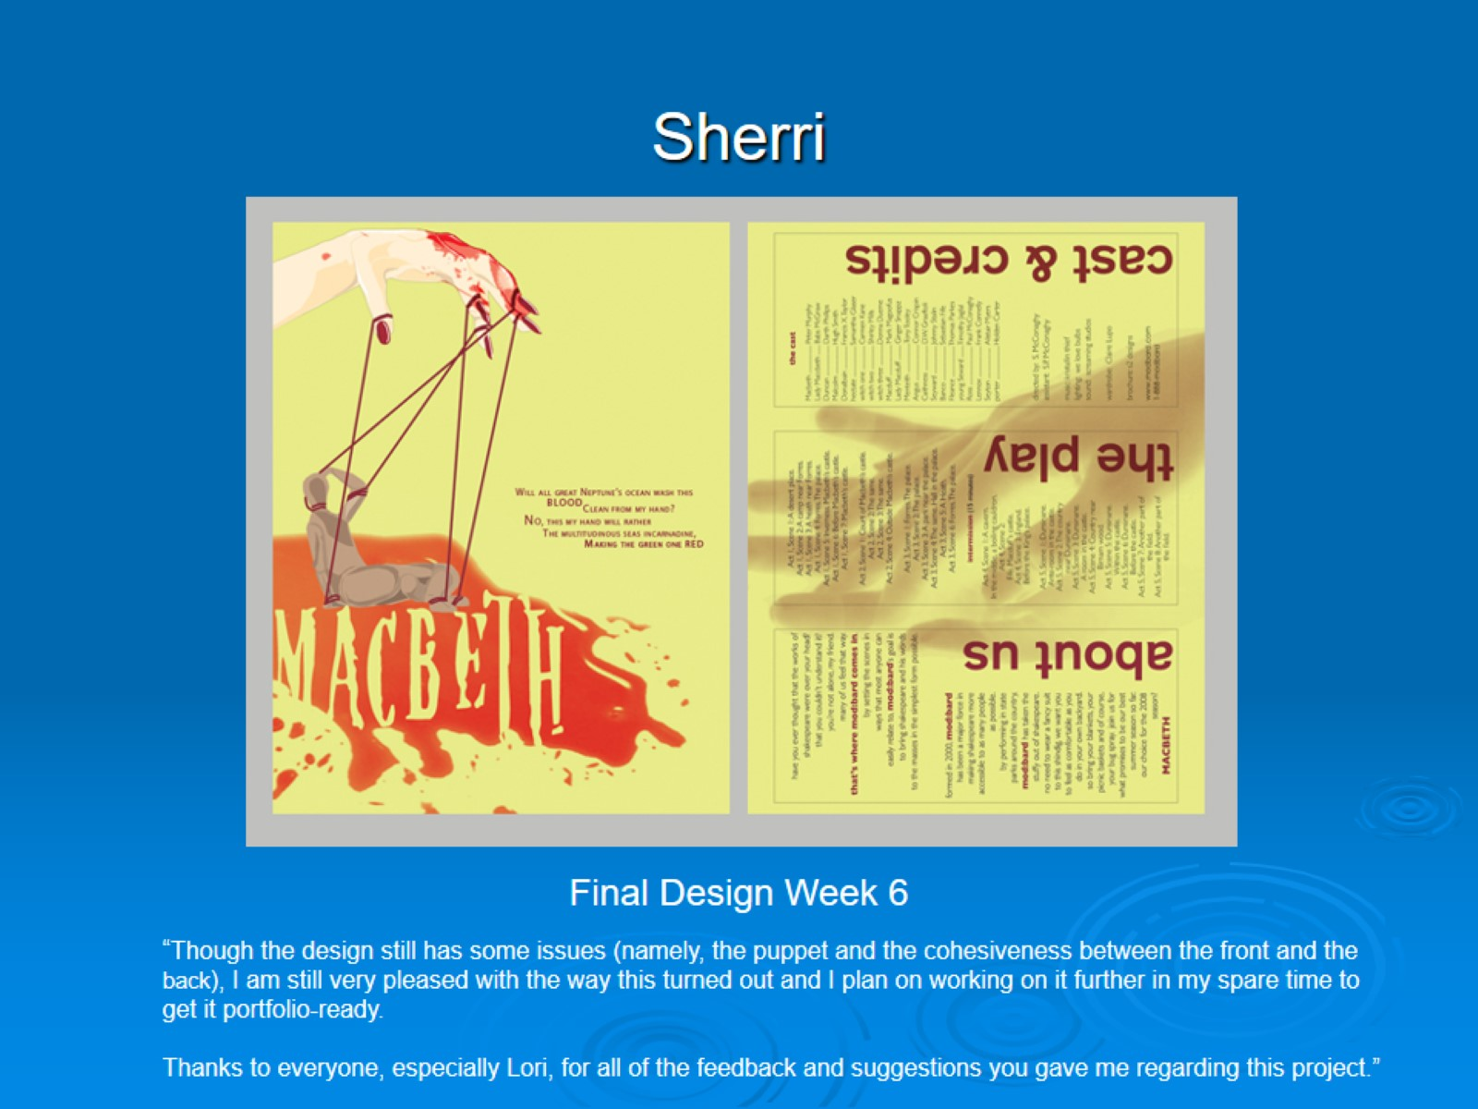
Sherri

Slide 27
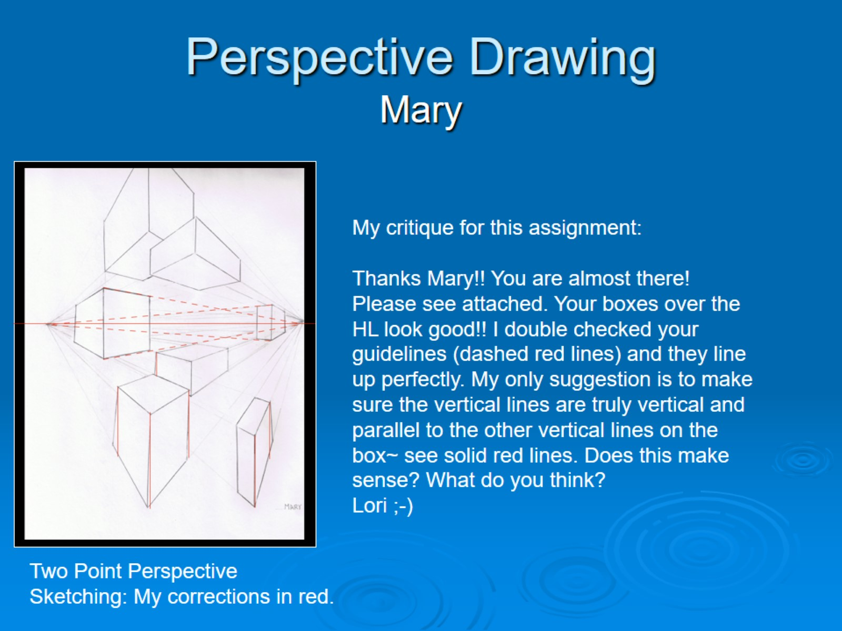
Perspective Drawing Mary

Slide 28
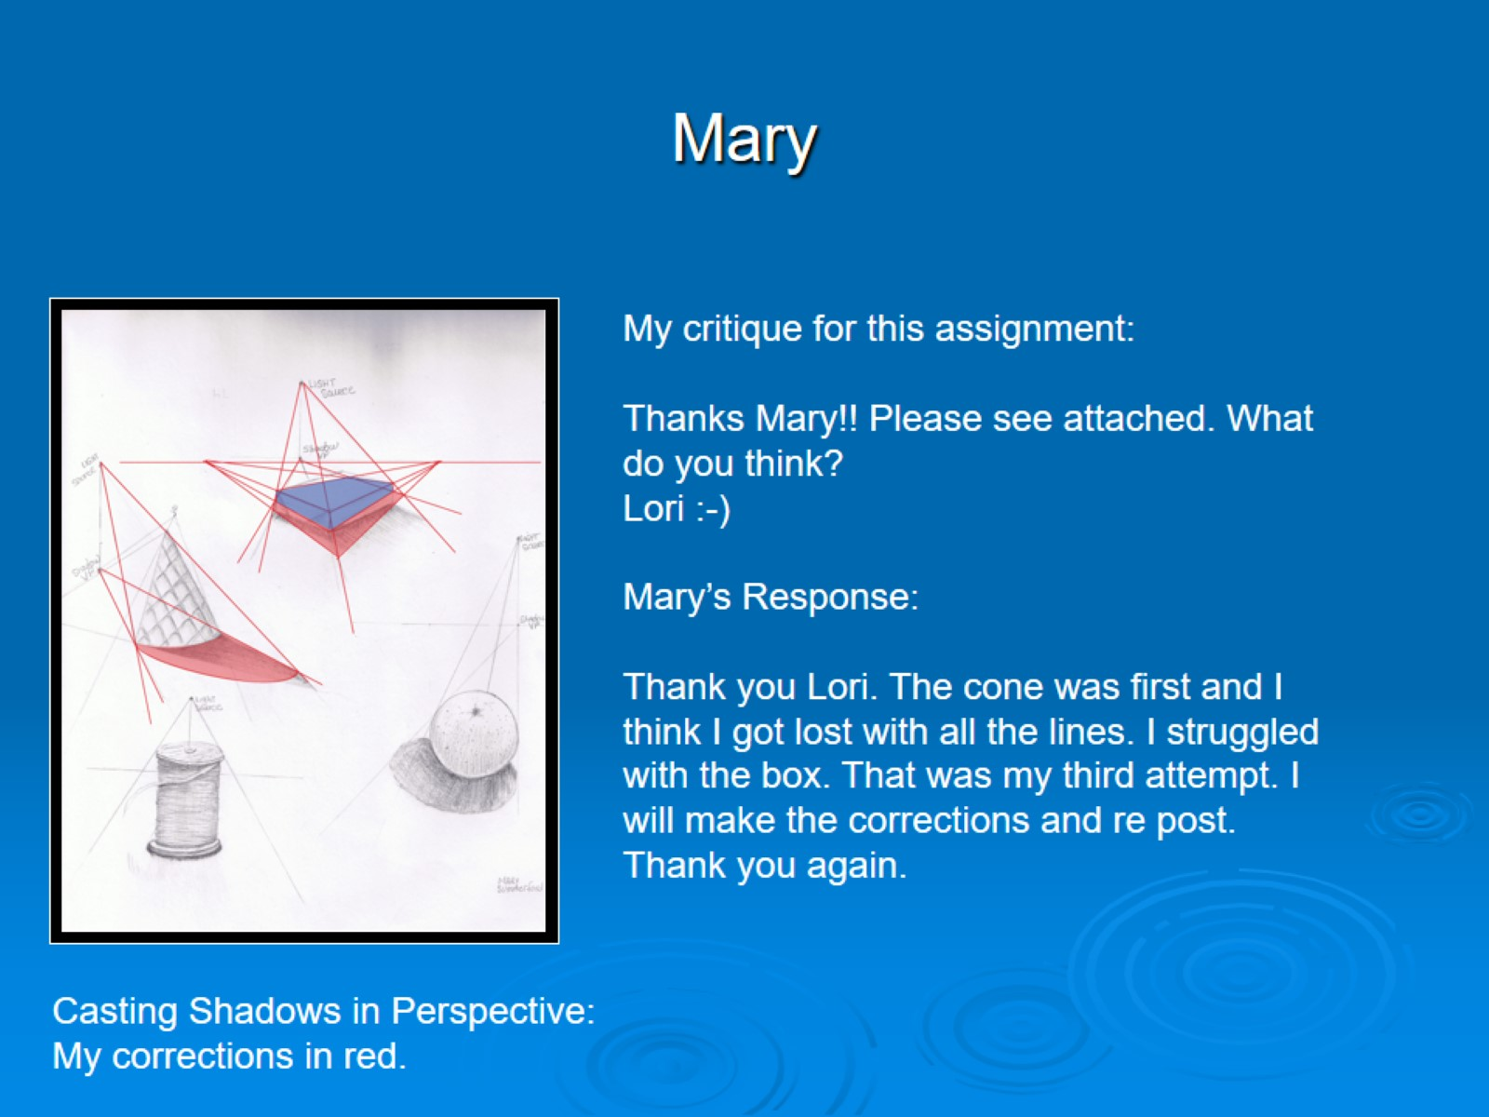
Mary

Slide 29
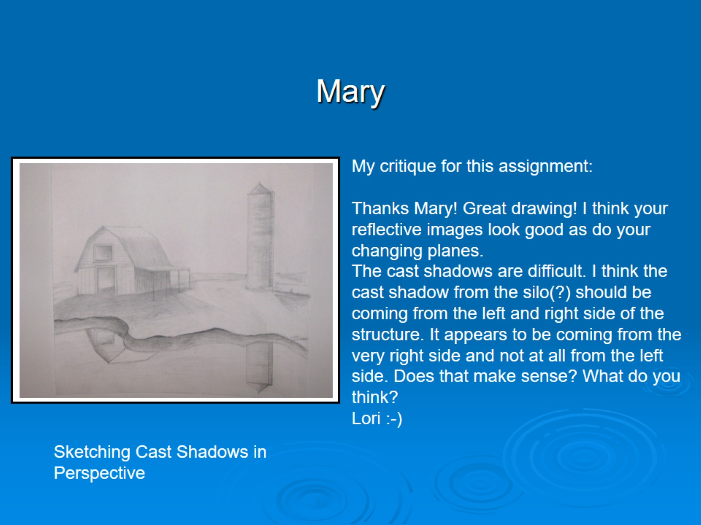
Mary

Slide 30
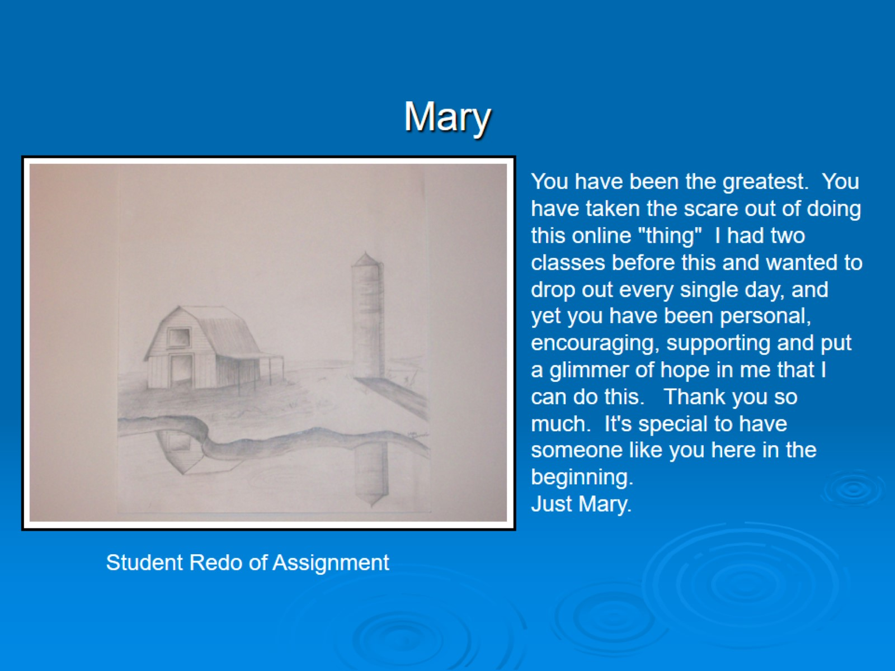
Mary

Slide 31
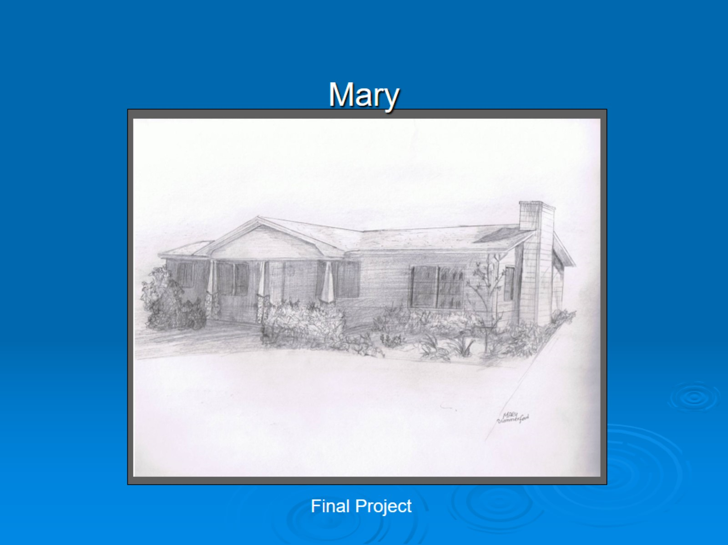
Mary

Slide 32
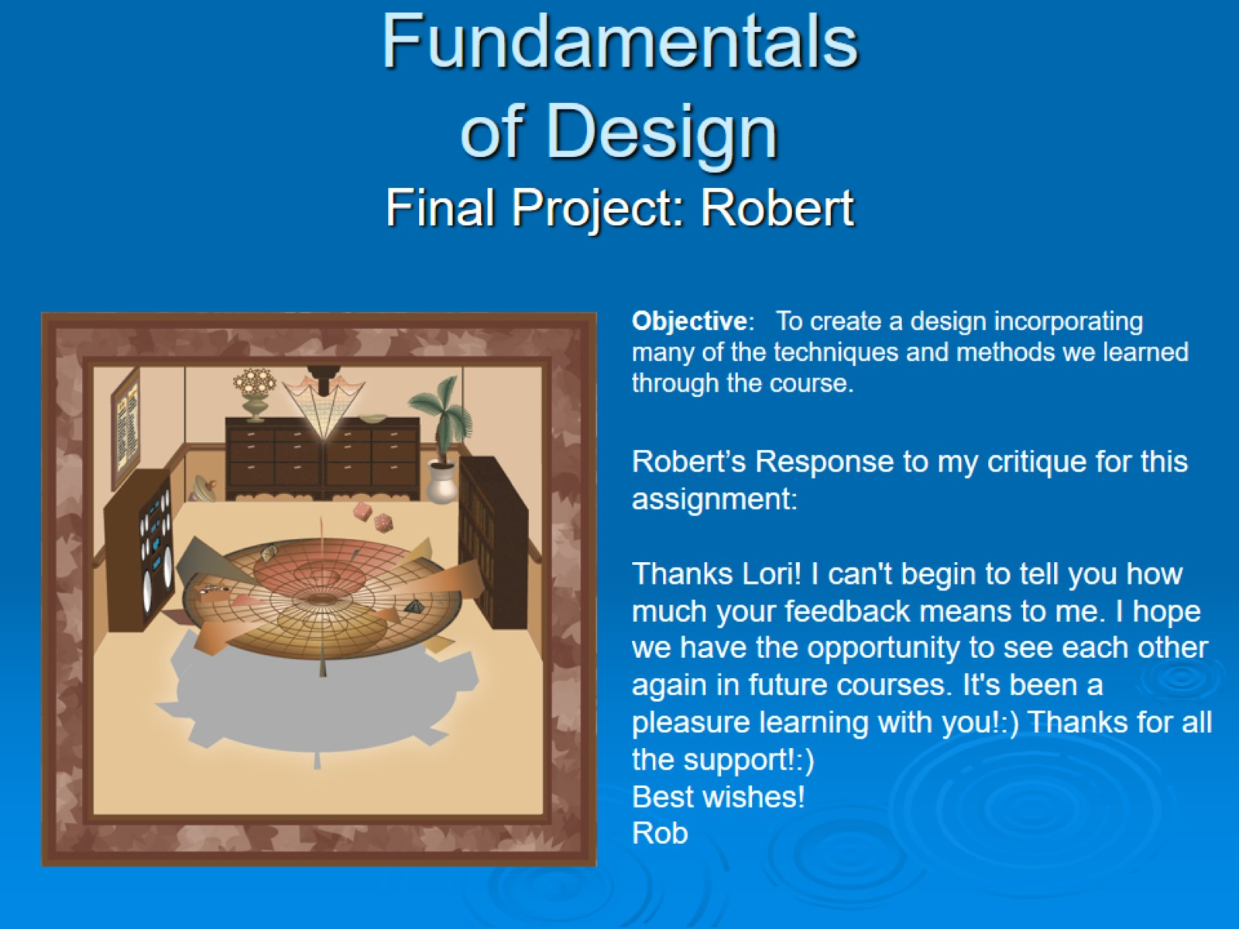
Fundamentals of Design Final Project: Robert

Slide 33
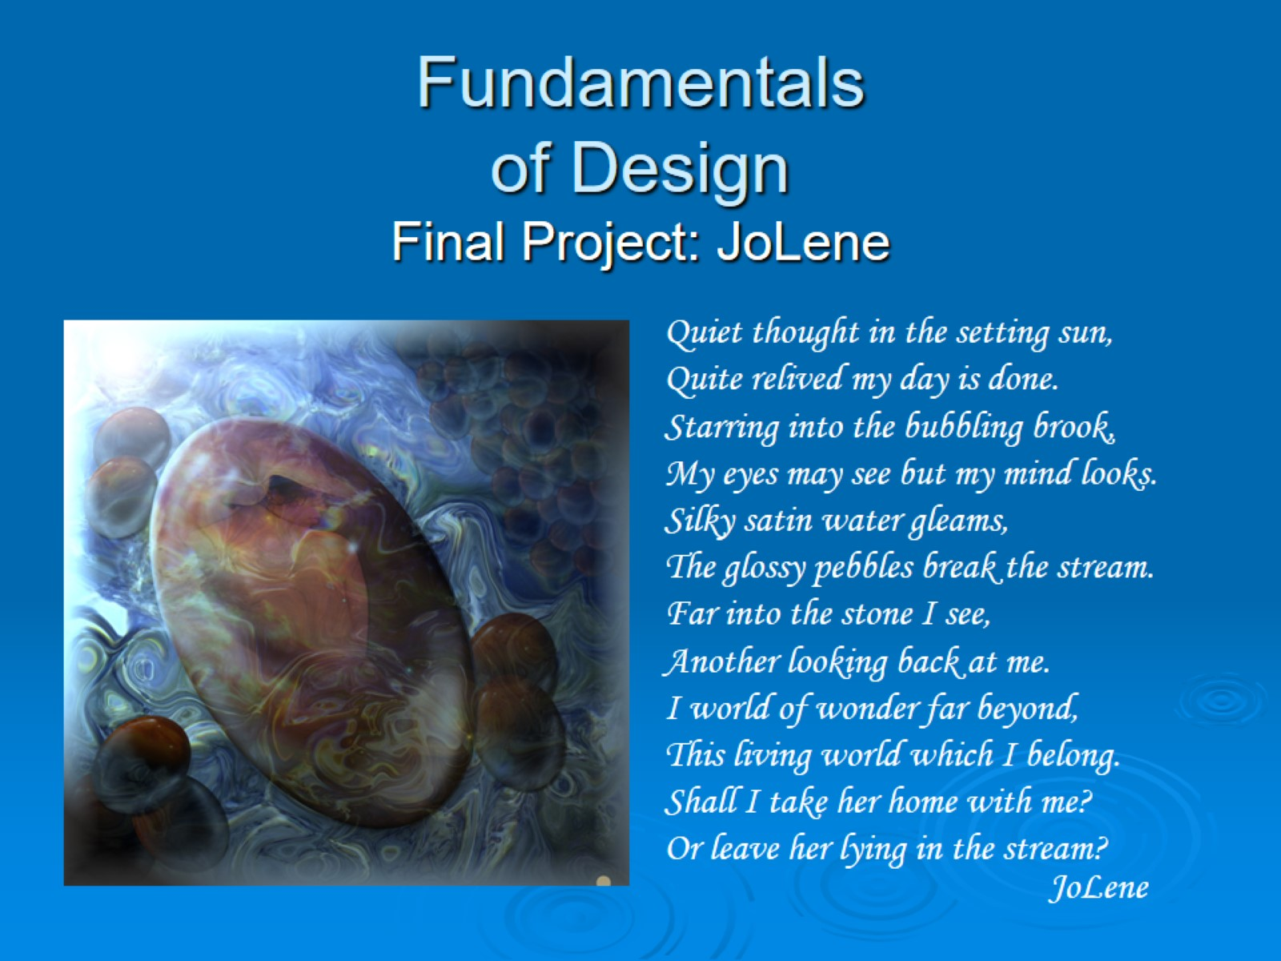
Fundamentals of Design Final Project: JoLene

Slide 34
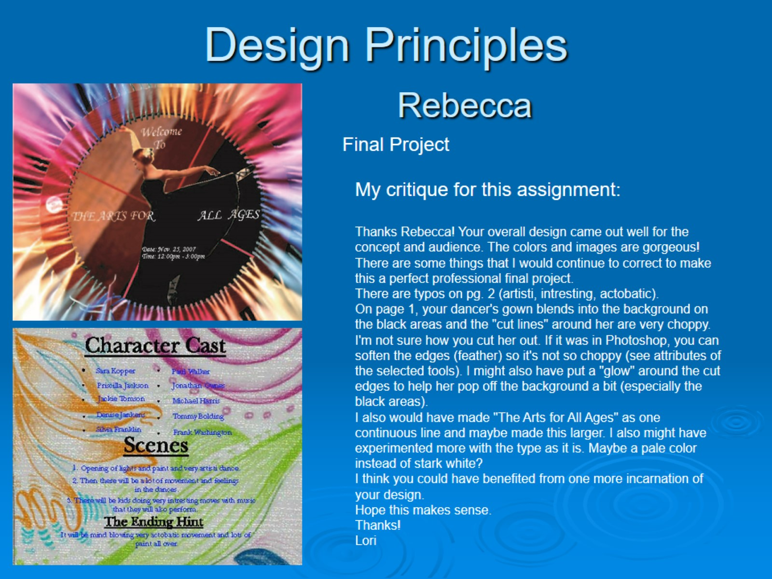
Design Principles Rebecca

Slide 35
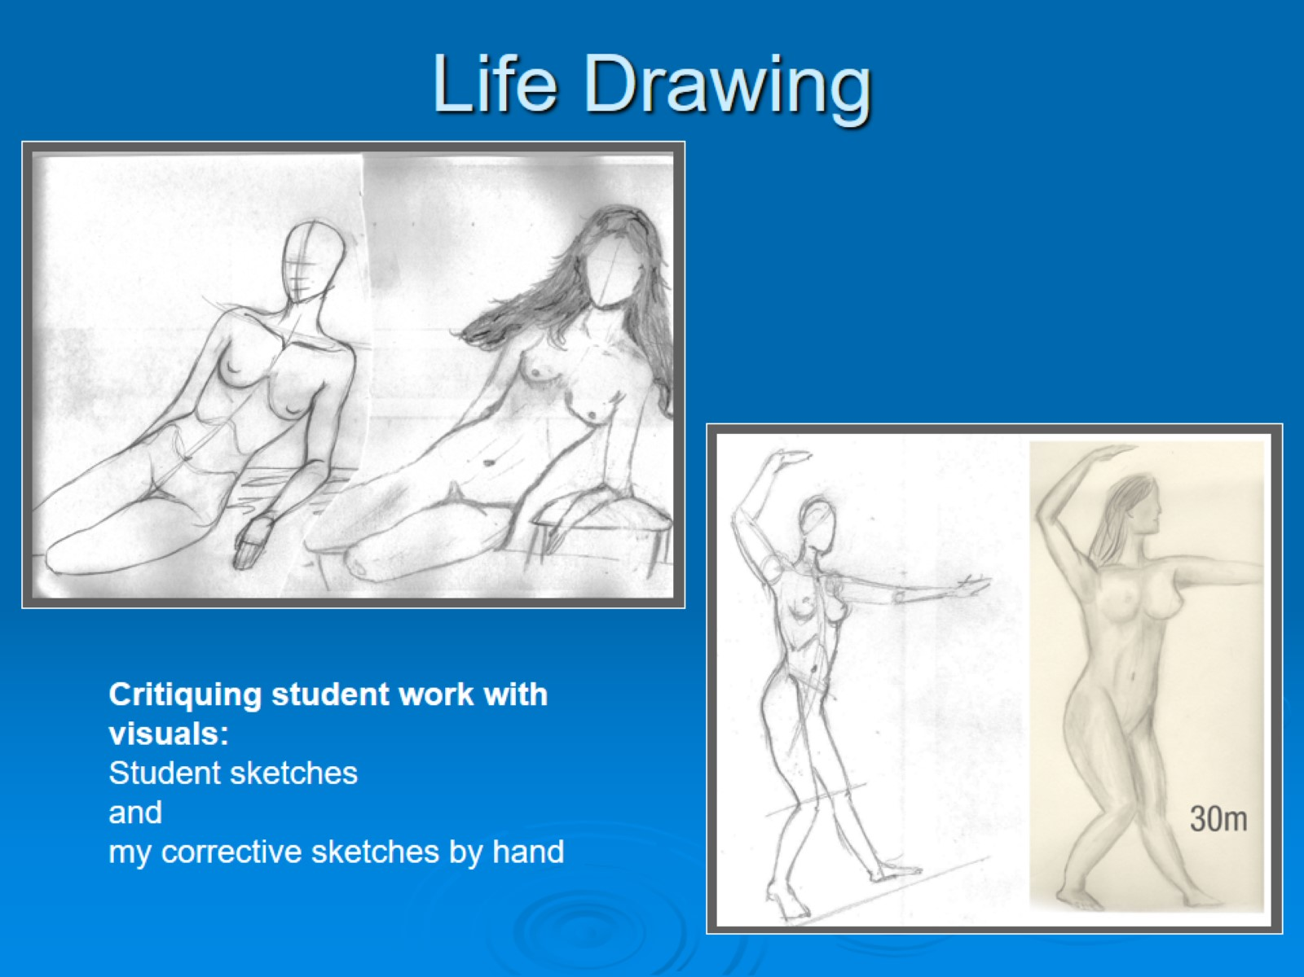
Life Drawing

Slide 36
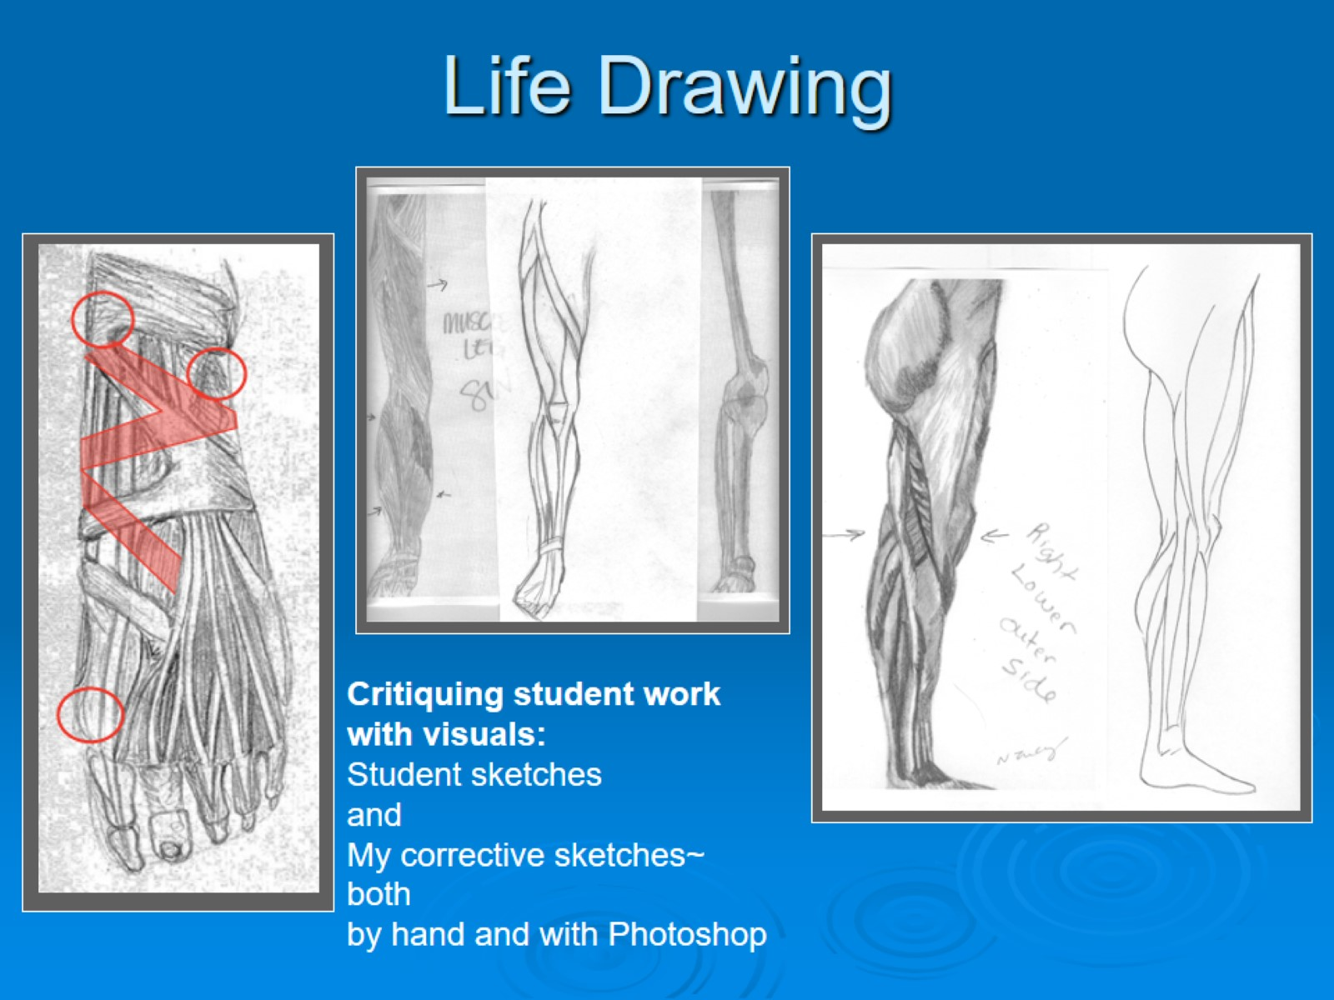
Life Drawing

Slide 37
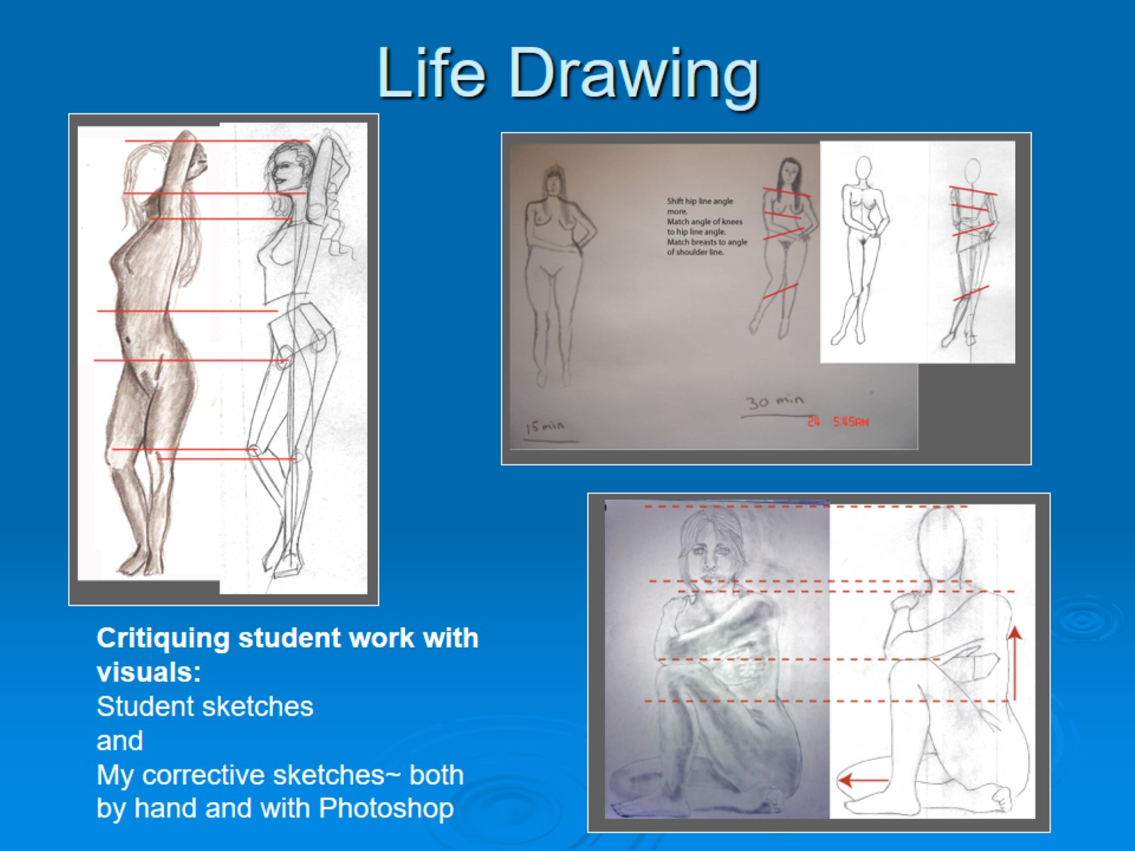
Life Drawing

Slide 38
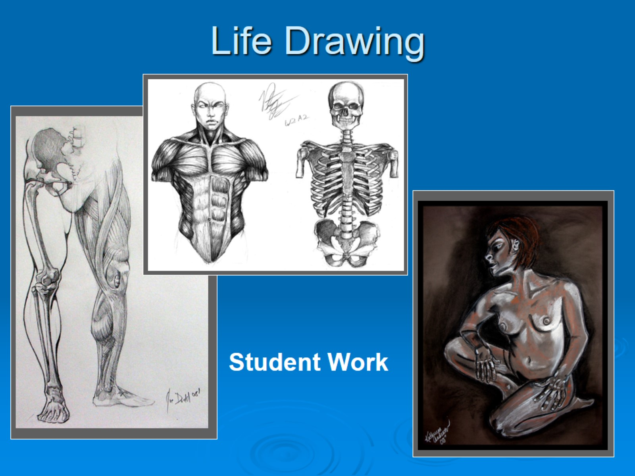
Life Drawing

Slide 39

Thanks for viewing my Portfolio!

